Slide 1
Image Encryption
By:
Krzysztof Pawlik x16138147
David Harrop x03298051

Slide 2
What is image encryption ?
“Visual cryptography is a cryptographic technique which allows visual information to be encrypted in such a way that decryption becomes the job of the person to decrypt via sight reading.”
https://en.wikipedia.org/wiki/Visual_cryptography

Slide 3
Why protect images by encryption ?
To provide Confidentiality of storing-sending images
To make sure that Integrity is easy to verify
To provide Authentication of images

Slide 4
Objectives:
Project problem:
Develop an application that encrypts the image.
Problem solution:
-Java application that take image file as an input
-Ask user for security password that meet specific requirement
-Encrypt it and store hashed (SHA-512) password in the file

Slide 5
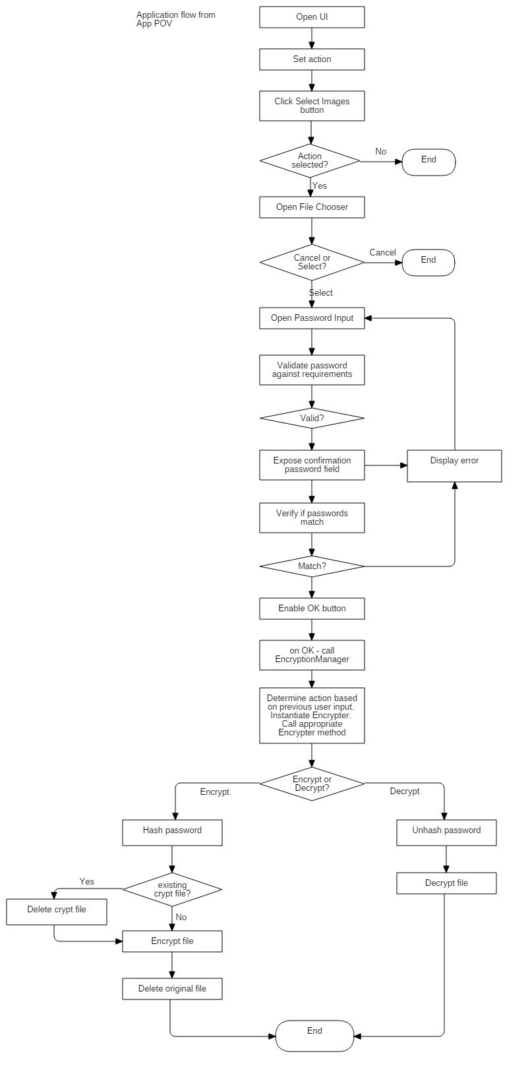
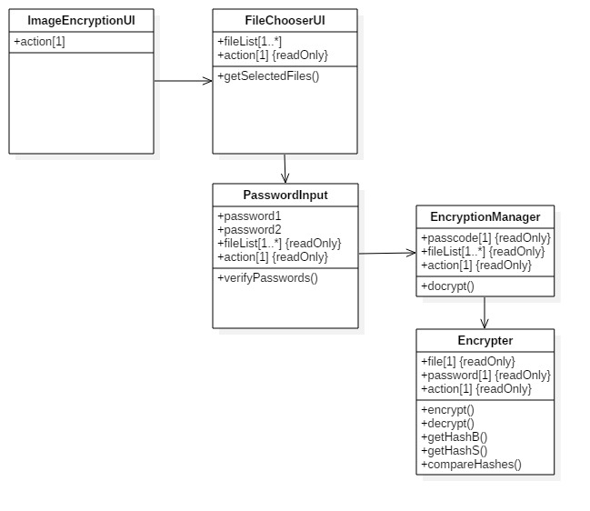
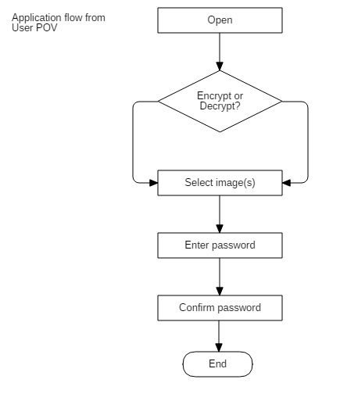

Slide 6

Code snippet –password verification

Slide 7

Code snippet –password hashing

Slide 8
Conclusion:

Slide 9

This Photo by Unknown Author is licensed under CC BY-SA

